Slide 1
Espn play-by-play api Matt Mckenna dsci 511, fall 2023

Slide 2
Sylabus expectations
Implementation of Data Set Construction with Documentation and Dissemination The Project Implementation will be graded based on the following rubric:
Project results, including a final dataset and code which makes it possible to re-construct the dataset
Documentation (including Jupyter notebooks, ReadMe file, data dictionary and other supporting documents)
Distribution plan
Presentation (must have one slide/paragraph of workload distribution of each member in the team)
Submission

Slide 3
About the team
Matt McKenna
10 years in Financial Services
Seeking a Masters in Applied AI & ML
Looking to get hands-on with acquiring my own data and more comfortable in exploring real-world datasets
Want to be versatile in which data types I use (JSON and Pandas)
Sole team member

Slide 4


About the espn api
ESPN is a major network (TV and Internet) that specializes in Sports
They maintain many Sports-related data API’s, including several related to NFL Football
Player API: Organizes their player data
Team API: Organizes their NFL team data
Game API: Details for every NFL game, including result of every play
Limits: Not for commercial purposes and requests are limited to 10,000 per day; no Authorization required

Slide 5
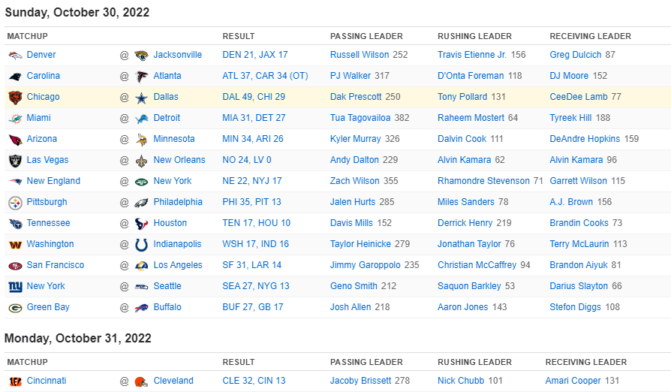
Using beautiful soup to get every game in 2022
The ESPN website has pages for every week of every season
These pages have predictable URL’s
I used BeautifulSoup to parse these pages
Cycle through all tables
Find the href link in each row’s “RESULT” column
From the link to each game, I extract the event_id

Slide 6
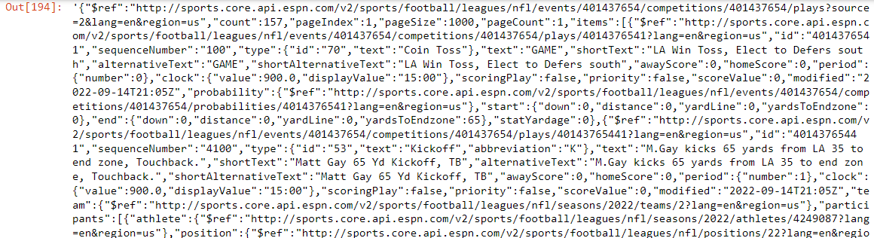
Using requests to get every play of every game
Now that I have event_id’s for every game in 2022, I can use requests to access the NFL Game API
The raw text (left) is very long: ~ 750,000 characters
With JSON, I converted to a Python dictionary (json_dict)
json_dict[‘items’] results in play-by-play info for the game (~175 plays per game)
Raw Text from API

Slide 7
Making json files with dictionaries
Game API
Player API
Play-by-Play Dictionary
Lists of Player Stats
JSON Files of Weekly Stats

Slide 8
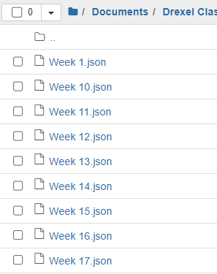
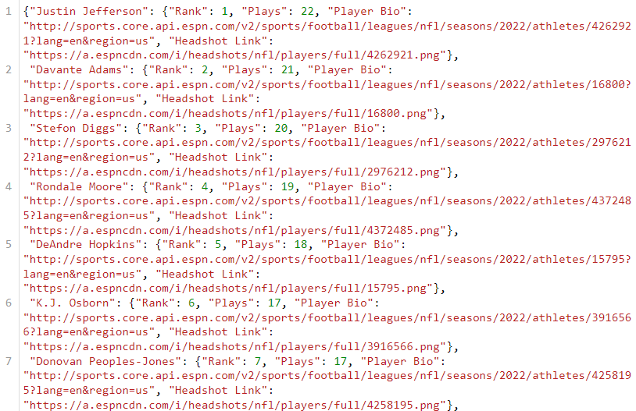
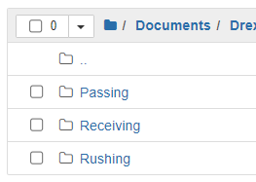
Organizing the json files
Project / Data / Receiving
Project / Data

Slide 9
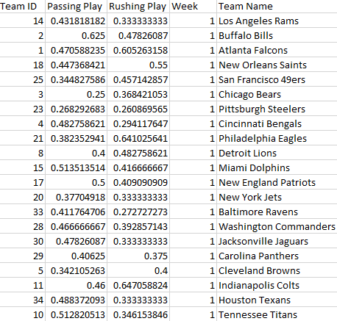
Making csv file with pandas
CSV Export
Pandas is a versatile data tool, and I used it for basic analysis
I went through every play of every game, and classified each play as “successful” or “unsuccessful” using logic from ProFootballFocus
I used Data Frames to calculate weekly and season statistics
I exported the weekly data to csv

Slide 10
Challenges, Distribution plan, and target audience
Challenges
Target Audience
Distribution Plan
The API’s I used did not provide metadata for the data I accessed
I was able to see the websites that the data appeared on, so that I had the context to use the data properly
The NFL has a large audience that has an interest in statistics
NFL Team Analysts
Casual Fans
Gamblers
Data: No plans to distribute, as I don’t intend to keep the data up-to-date
Codebase: Available as a Public repo on my GitHub
https://github.com/DallasMatt/ESPN_Scrape

